Slide 1
Front End Resistance Theory Bubble Trap

Slide 2
Observation and Idea
Initial observation was once air gets into bubble trap, it seems ‘ram rodded’ into trap which drastically increases the rate it needs to be removed from the system
If ram rodded front could be slowed down, air would come into trap at a more controlled rate and it would be able to be handled much more efficiently.

Slide 3
Model and Problem Framing
Fluidics act much like electrical circuits.
Pressure = voltage, flow rate = current, hydraulic resistance = resistance
Normally, fluids are incompressible and hitting one molecule makes then ‘feel’ the resistance of all of them. Even with a bubble, the gas will compress until it cant anymore in which case it approximates a fluid. In a bubble trap though, the air is rapidly removed. This creates something akin to a short to ground in electrical circuits. The fluid front coming in is decoupled from that after the trap. Thus its speed is only subject to the tubing resistance before the trap. If that is much lower than the rest of the circuit, then that front will be greatly accelerated and thus create this ram rod effect.

Slide 4



Bubble trap/GND
Fluid filled tube
$$dist= x_{0}$$
Air filled tube
$$dist= x_{1}$$
We have a tube with fluid that is $x_{o}$ distance into tube. The rest between this front and the trap is just air.
The trap is assumed to be a true GND and thus no back resistance is added in.
In general the time for an object to travel x distance is:
$$t= \int_{0}^{x}{\frac{∆x}{V(x)}}$$
Where V(x) is the velocity that depends on x position
If V(x) = constant then this problem is trivial. In our case this is not true.

Slide 5

Defining V(x)
Akin to Ohms law, V=IR, we have P = (flow rate)(fluidic resistance)
We have tubing with 500um ID and is measured in mm in length, P is in mBar
We desire the flow rate to not be in uL/min, but instead in mm/min where mm is mm of tube length traveled
Using Elveflow’s online calc we find fluidic resistance = 0.0013 per mm = C
Since the fluid starts off with some tubing occupied we must have an offset in the function as well.
$$V\left(x\right)=\frac{P}{C∗\left(x\right)}$$

Slide 6
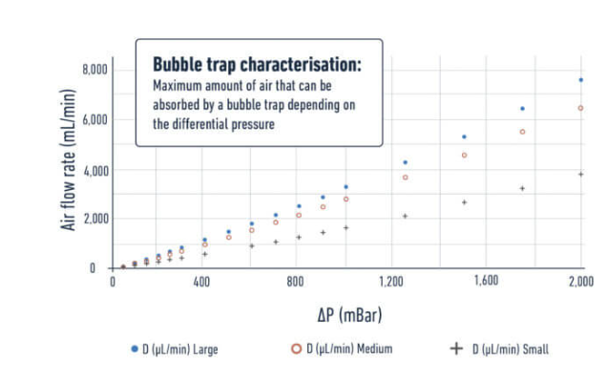


Solve
$$t= \int_{x_{0}}^{x_{1}}{\frac{∆x}{V(x)}=\int{\frac{∆x ∗C∗(x)}{P}= \frac{C}{P}∗\int_{x_{0}}^{x_{1}}{∆x∗\left(x_{0}+x\right)= \frac{C}{P}∗} ( \frac{x^{2}}{2}}) eval at x_{0} to x_{1} }$$
$$t= \frac{C}{P}∗(\frac{x_{1}^{2}}{2})$$
$$air supply rate=A= \frac{x_{1}}{t}= \frac{P ∗ x_{1}∗0.19625}{C∗(\frac{x_{1}^{2}}{2})}, if x_{0}=0, ASR= \frac{0.3925∗P}{C∗x_{1}}$$
For our system, C = 0.0005 and P = 1500mBar. The tube length = 200mm = x1 for this in a fully unprimed state of x0 = 0
ASR$= \frac{0.3925∗1500}{0.0005 ∗200}=$ 5887 uL/min
*Note this is not peak air flow into trap rates. Its merely an average over time = t interval.
Note too this is in turbulent regime and thus may be slightly inaccurate
Looking at the given AFR, its peak it can remove is 4500 uL/min.

Slide 7

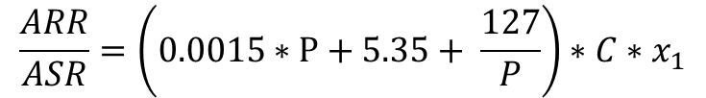
Discussion and Thoughts on main Problem
We can instantly see some repercussion in this result.
Higher pressure = more max air removal, but at the same time also forces in air faster. Finding a 2nd order fit to the ARR vs pressure we find
$$ARR=0.0006∗P^{2}+2.1∗P+50$$
$$\frac{ARR}{ASR}=\left(0.0015∗P+5.35+ \frac{127}{P}\right)∗C∗x_{1}$$
Its instinctive to believe that boosting max air removal rate will equate to removing bubbles better. The ARR/ASR is an important ratio as it both attributes depend on the pressure. One rams air into the trap and one removes it faster. So looking at a normalized graph of the ratio tells us the relative effectiveness of removing air from the system. Outside of lower pressures, it does have a net benefit, but its much lower than one would initially guess. Going from 500mBar to 1500mBar only gives about 25% more net effectiveness in removing air

Slide 8
Thoughts Continues
Its natural to feel a bigger bubble = harder to remove from the system. Notice in the ASR equation that the larger the bubble, the lower the average rate is. Burst will be higher as evident by the derivative of it, but it slows down over time which in turn lowers the average.
Given we established that absolute fluid pressure gives only minor net gains in air removal capacity, it might be more prudent to set our sights on a different aspect, namely how to slow down the incoming front.
Using a vacuum to increase pressure differential is much much more impactful to air removal rate as it increases the rate air can be removed while not increasing the pressure in the system and does not affect fluid flow rate.

Slide 9


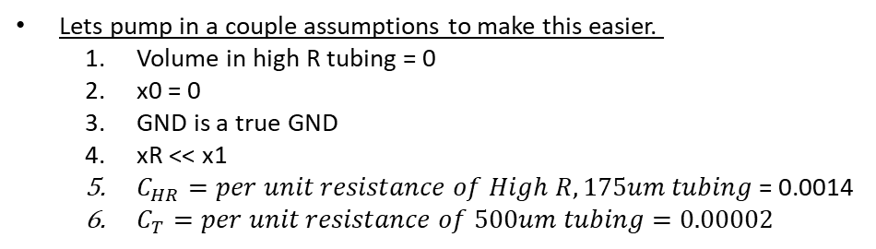

New Piecewise problem
Bubble trap/GND
High Resistance tube
$$dist= x_{R}$$
Fluid filled tube
$$dist= x_{0}$$
Air filled tube
$$dist= x_{1}$$
Lets pump in a couple assumptions to make this easier.
Volume in high R tubing = 0
x0 = 0
GND is a true GND
xR << x1
$C_{HR}=per unit resistance of High R, 175um tubing$ = 0.0014
$C_{T}=per unit resistance of 500um tubing=0.00002$
$$t = \frac{C_{HR}}{P}∗\int_{0}^{x_{R}}{∆x∗\left(x\right)+\frac{C_{T}}{P}∗\int_{x_{R}}^{x_{1}}{∆x∗\left(x\right) }= }\frac{C_{HR}∗x_{R}^{2}}{2∗P}+\frac{C_{T}}{P}∗(\frac{x_{1}^{2}}{2}−\frac{x_{R}^{2}}{2})$$

Slide 10

${ASR}_{HR}=\frac{0.1963∗x_{1}}{\frac{C_{HR}∗x_{R}^{2}}{2∗P}+\frac{C_{T}}{P}∗(\frac{x_{1}^{2}}{2}−\frac{x_{R}^{2}}{2})}= \frac{.3925∗P∗x_{1}}{\frac{C_{HR}∗x_{R}^{2}}{2∗P}+\frac{C_{T}}{P}∗(\frac{x_{1}^{2}}{2}−\frac{x_{R}^{2}}{2})}$
$${ASR}_{LR}=\frac{0.3925∗P}{C_{T}∗x_{1}},$$
Sub in 125mm for 500um line
$$\frac{{ASR}_{HR}}{{ASR}_{LR}}=\frac{{C_{T}∗x}_{1}^{2}}{C_{HR}∗x_{R}^{2}+ C_{T}∗\left(x_{1}^{2}+x_{R}^{2}\right)}=\frac{0.0002∗x_{1}^{2}}{0.0014∗x_{R}^{2}+0.00002∗\left(x_{1}^{2}+x_{R}^{2}\right)}=\frac{0.325}{0.00142∗x_{R}^{2}+0.325}$$
Notice adding 31mm of 175um tubing, reduces the ASR by almost 80%
This points to high resistance tubing being right out of reservoir as being much more impactful than modulating system pressure.

Slide 11
Realistic System
We need to convert model into most realistic system
While it would be best to have the restricted tube right after the reservoir, it isn’t easy to install as I need one for each. A more streamlined approach is a 500 line to the MUX, the restricted line and then a 500 out of that into the bubble trap
We need a metric that makes more sense too. ARR/ASR is a nice metric and it relates the air removal rate to the supply rate inside of the bubble trap.
Given issues exist with this simplistic model, I want to use maximums and not exactly numbers to just get rid of bubbles. This is mostly due to peak rates most likely exceed what the bubble trap can do, but average rates can be handled.
Bubble trap/GND
Realistic System
MUX
0 to x0
x1 to x2
X0 to x1

Slide 12
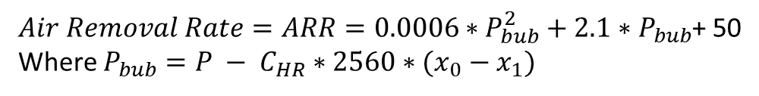
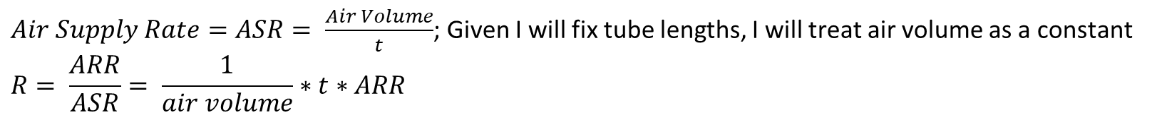
$$t =\frac{C_{T}}{P}∗\int_{0}^{x_{0}}{∆x∗\left(x\right) }+\frac{C_{HR}}{P}∗\int_{x_{0}}^{x_{1}}{∆x∗\left(x\right)+\frac{C_{T}}{P}∗\int_{x_{1}}^{x_{2}}{∆x∗\left(x\right) }= }\frac{C_{HR}}{2P}∗(x_{1}^{2}−x_{0}^{2})+\frac{C_{T}}{2P}∗(x_{0}^{2}−x_{1}^{2}+x_{2}^{2})$$
$Air Removal Rate=ARR=0.0006∗P_{bub}^{2}+2.1∗P_{bub}$+ 50
Where $P_{bub}=P − C_{HR}∗2560∗(x_{0}−x_{1})$
$Air Supply Rate=ASR= \frac{Air Volume}{t}$; Given I will fix tube lengths, I will treat air volume as a constant
$$R= \frac{ARR}{ASR}= \frac{1}{air volume}∗t∗ARR$$
Fixing first tube length as 200mm and second that goes to bubble trap as 100mm.
Make internal pressure 1000mBar
Make flow rate 500uL/min or 2560 mm/min in 500um diameter tubing.

Slide 13
Recommended Solutions
Reduce overall system pressure. Drop from 1500mBar to 1000mBar by reducing total restriction line to 28cm of 175um line
Place 150mm of the 175 tubing to come out of MUX unit, the other 130mm section should be after the flow meter.
Projected efficiency is around 50 times higher capacity to remove gas from the system in this configuration
One caveat here is liquid wont slow down until it hits the restricted portion. In this case if the premux tubing is very long compared to the post restriction portion, the air can still be jammed in rapidly until the liquid hits that restricted part. The number shown are averages, not instantaneous. We do have 92uL of internal volume in the bubble trap which gives us the ability to absorb and spread out the flow spike until it dies down.

